Slide 1
Project LOOM
A Rapid Prototyping System for Internet of Things Applications
Trevor Swope, Luke Goertzen, Will Selbie

Slide 2
Recap of Purpose and Goals
With Project LOOM, we aim to create an open-source, plug-and-play, suite of modular building blocks. Desired high-level properties of the project are:
Extensibility
Easy programmability
Accessibility to beginners through abstraction of technical details
Learnability
Versatility
Modularity
This is done by building a system that abstracts out the more technical details, allowing users to focus on their system rather than the implementation of the modules if they want

Slide 3
Overview of Current Project Status
Project continues to progress smoothly
Currently working on demos for an upcoming open house of the OPEnS lab and a faculty meeting in early March
Current hardware and codebase is being used by Chet in his Data Driven Enchanted Objects Honors College colloquia class

Slide 4
Individual Breakdown of Progress

Slide 5
Luke
User Interface
External visualization of I/O
Event and Notifications

Slide 6
Max Modules for Actuators
Each hardware device generally has a specifically tailored Max/MSP control module / interface
Primary Actuators
Neopixels
Servos
Relays

Slide 7
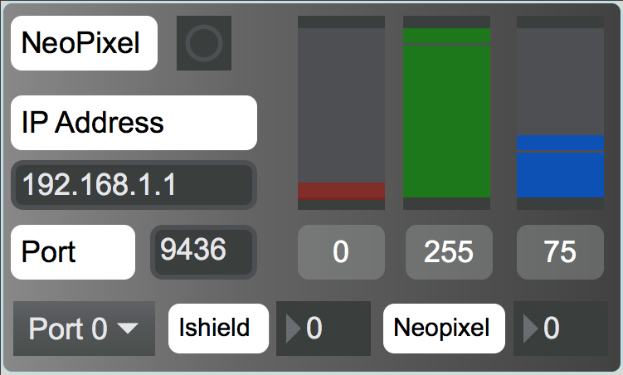
Neopixel

Slide 8
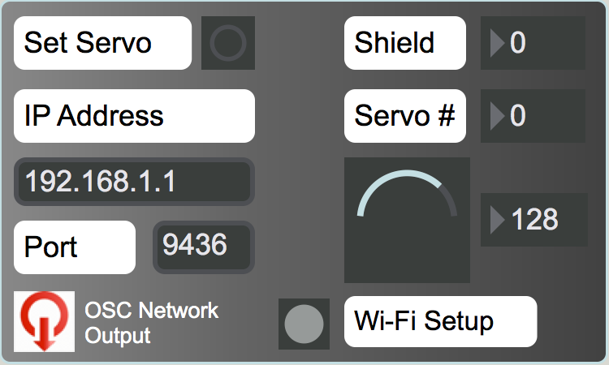
Servo

Slide 9
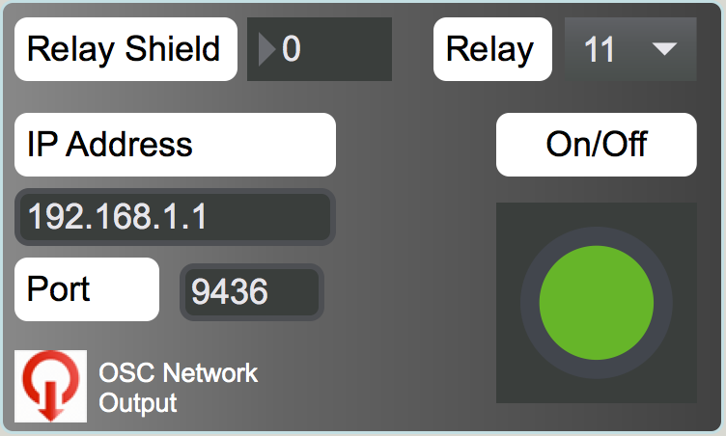
Relay

Slide 10
Max Modules for Sensors
The primary sensors used in Project LOOM continue to be those of the Ishield
MPU6050
Accelerometer and gyroscope
Sensors plugged into one of the 3 general purpose ports
A relatively new sensor is the GS3 Soil Moisture sensor
Input from a LOOM network can usually be received from the comprehensive LOOMin Max module
The Ishield Monitor is focused specifically on the configuring and reading data from Ishield connected devices

Slide 11
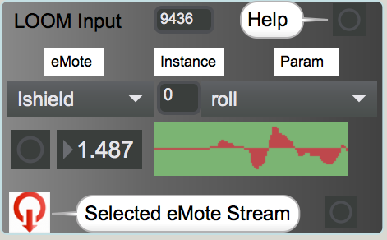
LOOMin

Slide 12
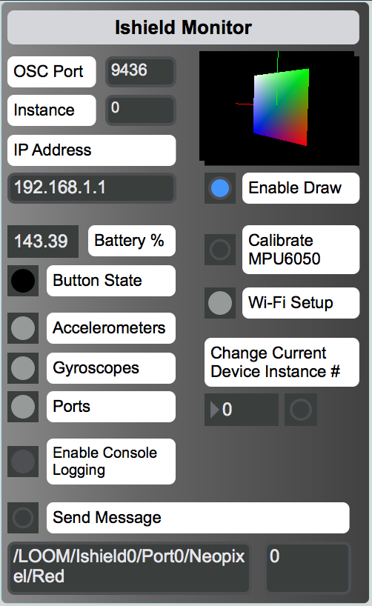
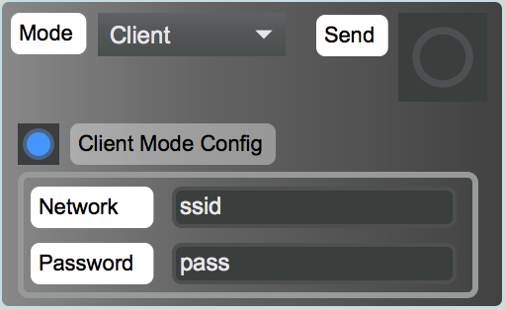
Ishield Monitor

Slide 13
Additional Work
Using code templates created by Trevor to implement new functionality or to bring existing code to a standardized format
Retroactively adding client mode WiFi options to existing firmware
Updating the OSC message format for devices such as the Neopixels and servos to be more versatile with a simpler parsing scheme

Slide 14
Difficult Problems
Not too many difficult problems
Getting Neopixels to work in a plug-and-play fashion on arbitrary ports
Maintaining a reliable servo demo

Slide 15
What is Left to Do
External visualization of I/O and events and notifications are being deferred until:
Adding new hardware is no longer primary concern
Existing hardware’s firmware exists in at least some form
I/O visualization will be to make it easy to link visualization services to a LOOM network
Adafruit IO
Plotly
Incorporating events and notifications will be similar, interfacing with:
Adafruit IO
IFTTT
PushingBox

Slide 16
Trevor
Networking Protocols
Data Transfer Formats
Communication Interface

Slide 17
WiFi Client Mode vs. Access Point Mode
Prior to this term, all WiFi connection has been done by having the board act as an access point, and connecting to it with a computer.
To use multiple devices on the same network, they must each act as a client connecting to a central router or host
Devices must be able to switch dynamically between access point mode and client mode depending on what the user needs
Basic use case is:
User flashes firmware for the first time, board is an access point mode
User configures instance number for the shield
User connects the shield to a WPA network, shield saves config
Shield restarts, stays in client mode
User can also reset back to access point by holding a button

Slide 18
Dynamic Device Configuration
User can now change the instance number of the device, and it is stored in non-volatile memory for when the device starts up next.
The expected header “/LOOM/Ishield0” becomes “/LOOM/Ishield4” upon receiving the command “/LOOM/Ishield4/SetID 4”
The MPU6050 can receive a new calibration command from the user. Similarly, the structure exists to receive new configuration commands--this will be important when we implement MQTT and IFTTT integration.

Slide 19
LOOM Firmware Driver
The most basic abstract functionality of a board is universal to any application. A board needs to:
Receive commands
Process commands
Send data
Since each of these basic functions is common to any application, the control flow of any application is common as well.
We created a generic driver containing functionality to parse incoming commands, process them, and send data, depending on the configuration determined by preprocessor directives
The idea is that the user will eventually be able to specify these things without even looking at their code

Slide 20
Difficult Problems (and other thoughts)
Need to ensure that the internal states of the WiFi and UDP components of the board are not corrupted when switching between modes
It has been very important to ensure that all previous connections are terminated
New connection must be fully established before accepting new connections. If this is not correctly done, it can cause the entire board to halt.
By adding a small delay after any of these functions, we ensure the success of the transition.
I think a more robust solution might be necessary; we could write a full reset function which clears all network states and re-initializes them every time we need to change the connection; this way, there will not be anything unaccounted for.
We are still having some issues integrating the servo functionality into the template driver, but I think we will solve it.

Slide 21
What is Left to Do
Configuration for a particular device in the driver is currently set by commenting, uncommenting or otherwise altering preprocessor directives at the top of the file
Ideally, this configuration is contained in a “config.h” file included in the top of the file. This file could be generated by the user to suit their particular setup in a simple user interface or another Max patch
Need to extend firmware driver functionality to include other actuators and sensors (relay, complete servo, decagon soil moisture sensor, etc.)
Need to extend firmware driver functionality to include LoRa and nRF capabilities
Need to add detection and handling for dropped connections and changes to the network state--devices need to run for a long time without maintenance or resets

Slide 22
William
Inter-Device Communication
Network Architecture
Node Control Structure

Slide 23
Inter-device Communication
Both development boards that are being used for the project (32u4 and M0) have been shown to be able to communicate using nRF and LoRa.
There is now a working translator that can convert from OSC Bundles to strings that are formatted to fit the OSC protocol, and vice versa.

Slide 24
Network Architecture
The network architecture used to be that any WiFi enabled board would set itself up as an access point and a computer would connect to the access point to send commands to it. Now, WiFi enabled boards start as access points and then the credentials of the network they should connect to are sent to them via OSC Bundles.
Both LoRa and nRF have been shown to work, so once we have more LoRa and nRF enabled boards available we can set up more complex networks, and eventually have a LoRa or nRF network communicate with a WiFi based network through an M0 with both WiFi and radio LoRa or nRF capabilities.

Slide 25
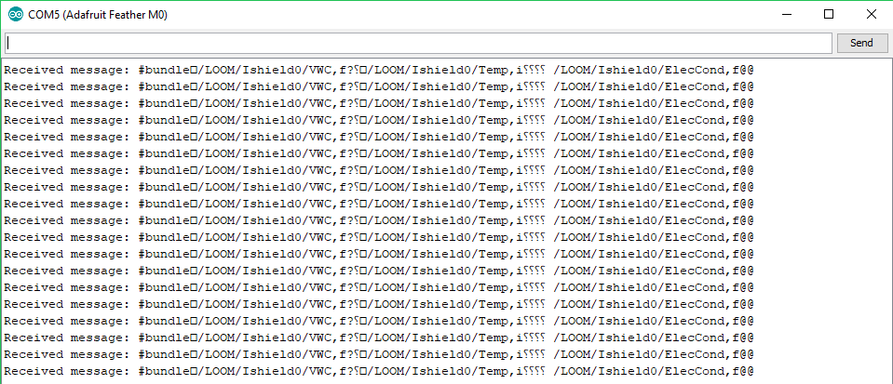

Slide 26
Node Control Structure
Not much has changed in the way of node control structure since Fall term. Each node is programmed to autonomously collect and send data back to the hub, typically on a timed interval. The biggest change is that Luke has made serious improvements to the graphical user interface, allowing users to easily send commands to alter the behaviour of nodes connected to the hub. Clearly anyone capable of writing their own code for the modules is able to decide on whichever node control structure they would like.

Slide 27
Decagon Soil Moisture Sensor
Cleaned up code - removed unneeded code and refactored remaining code
Incorporated the new OSC_Scheme template header
Added ability to receive OSC Bundles and set transmission time by receiving a command through an OSC Bundle

Slide 28
Difficult Problems
There have not been any exceptionally taxing problems that I have encountered over the course of Winter term. One issue has simply been in making sure each team that relies on the OPEnS Lab’s supplies has access to what it needs. As some of the sensors that Project LOOM needs to support can be expensive, the lab only has one to two of them. This can be troublesome as multiple teams will all need to test code on the same sensors, but so far this has been avoided just fine by communicating with the other teams that use the same resources.

Slide 29
What is Left to Do
Inter-device Communication
Need to thoroughly test an M0 with both WiFi and LoRa capabilities to verify translation from OSC bundles to strings following the OSC protocol and vice versa. It will then need to be able to efficiently relay messages from nRF and LoRa networks (which use the strings) to WiFi networks (which use OSC bundles) and in the opposite direction.
It would also be helpful to abstract WiFi, LoRa, and nRF capabilities into their own header files
Network Architecture
Test more systems in which there are multiple nodes on a network
Test out networks which contain multiple nodes as well as a hub which is used to relay commands to the appropriate nodes when needed.
Test inter-network communication
Node Control Structure
Continue writing base code for sensors and actuators that gives them autonomy while still accepting commands.

Slide 30
Conclusion

Slide 31
State of the Project
We have made a lot of progress in the past six weeks, and hope to continue on that streak.
We have a lab open house / faculty demonstration scheduled for February 19th and will be demonstrating use cases of the most functional of our sensors and actuators:
the MPU6050
the Neopixel LED
the servo
possibly the Decagon soil moisture sensors
By the end of the term, we hope to have fully integrated the relay shield, LoRa and nRF networking capabilities, and integrated a multiplexer for dynamic detection of connected devices.

